Slide 1
Modeling A Pursuit-Evasion Game Using Markov Chains
Group 33
Matt Verhoeven, David Chen,
Raluca Aron, Berend The

Slide 2

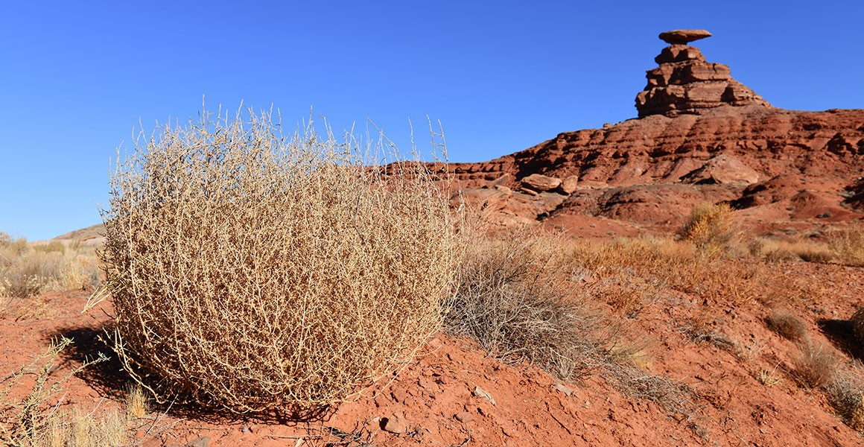

Slide 3
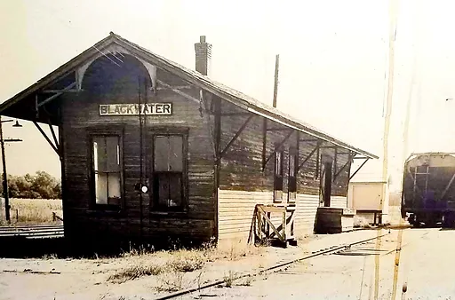

Slide 4
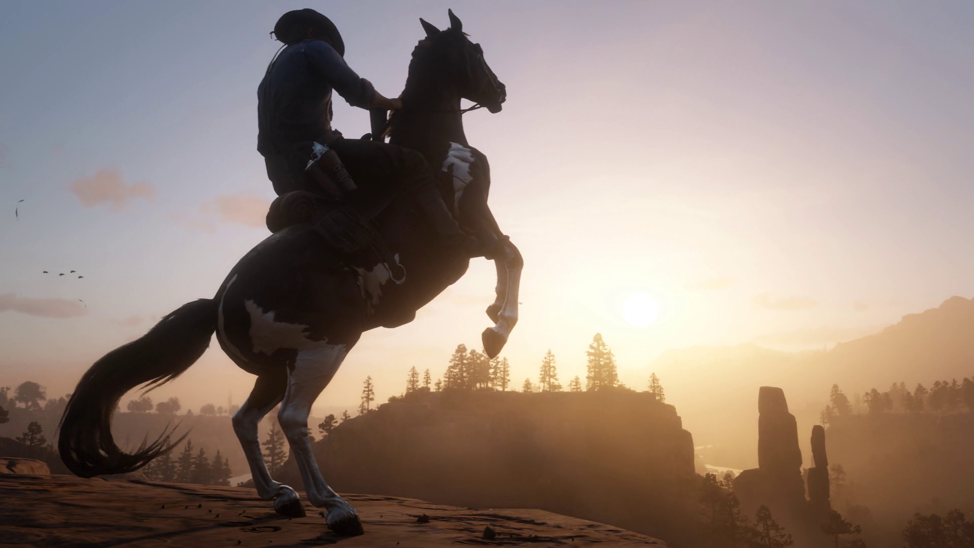
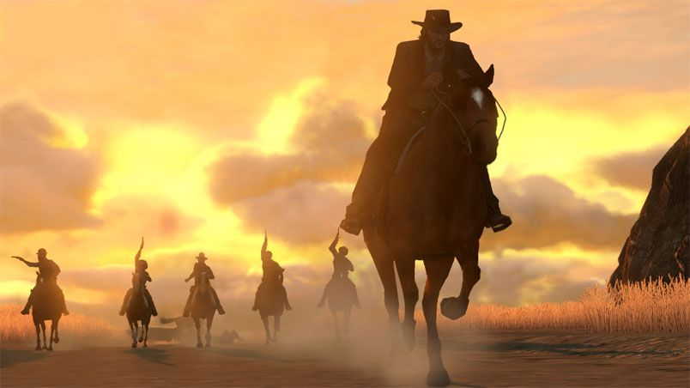



Slide 5
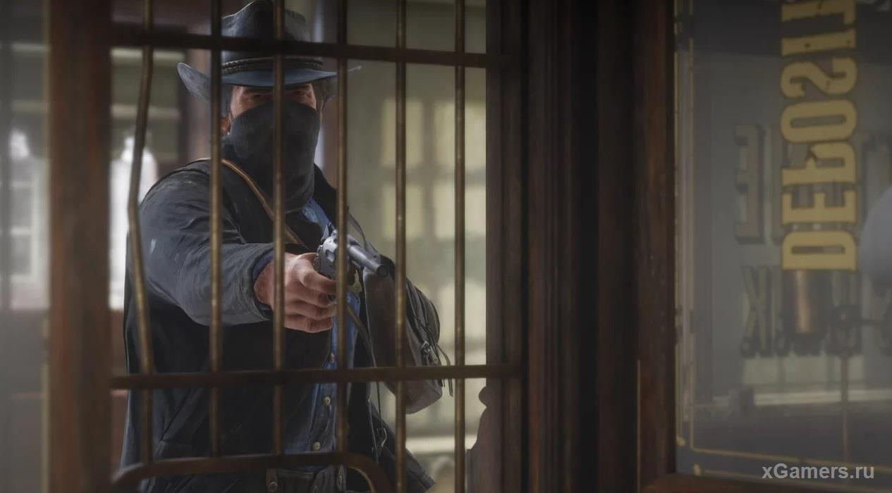

Slide 6
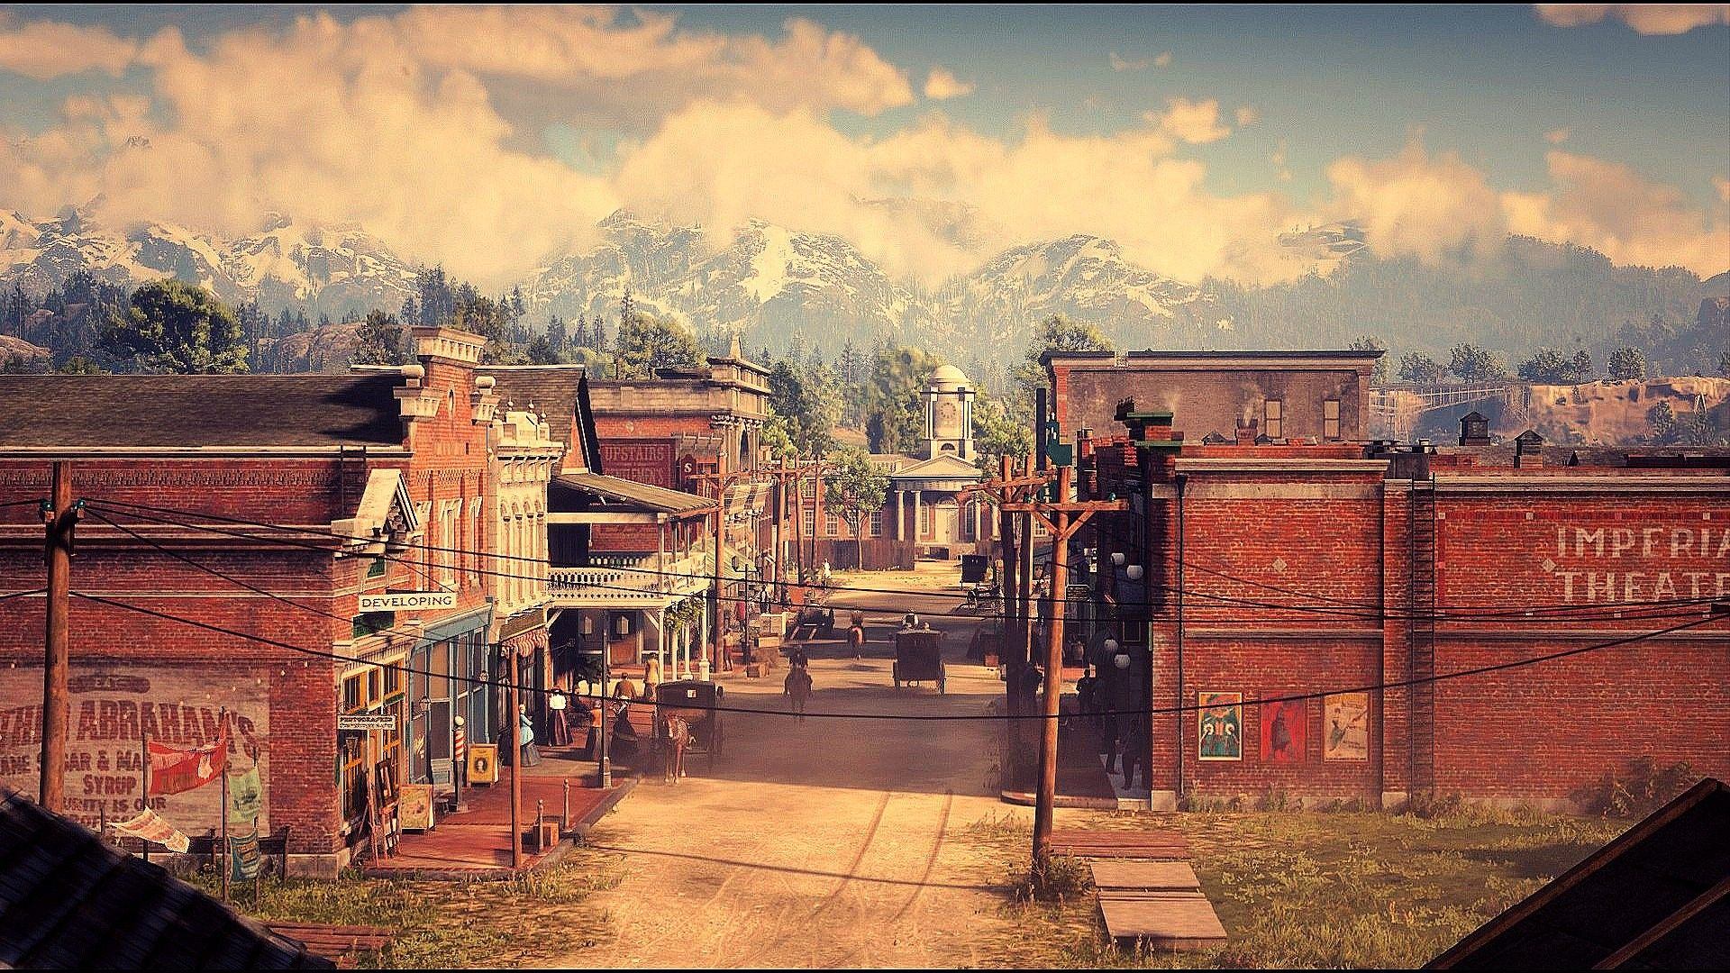

Slide 7


Slide 8


Slide 9
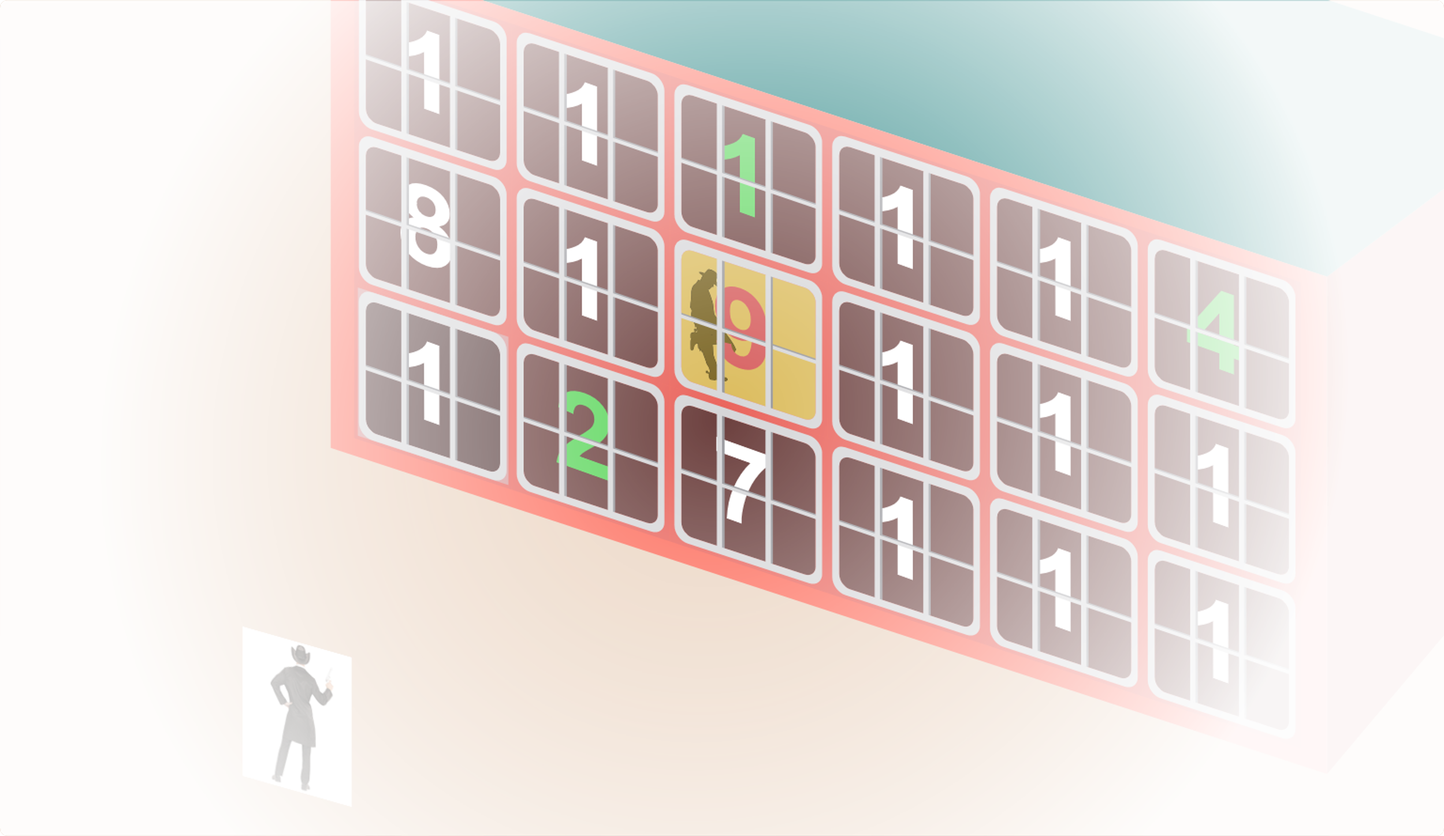

Slide 10
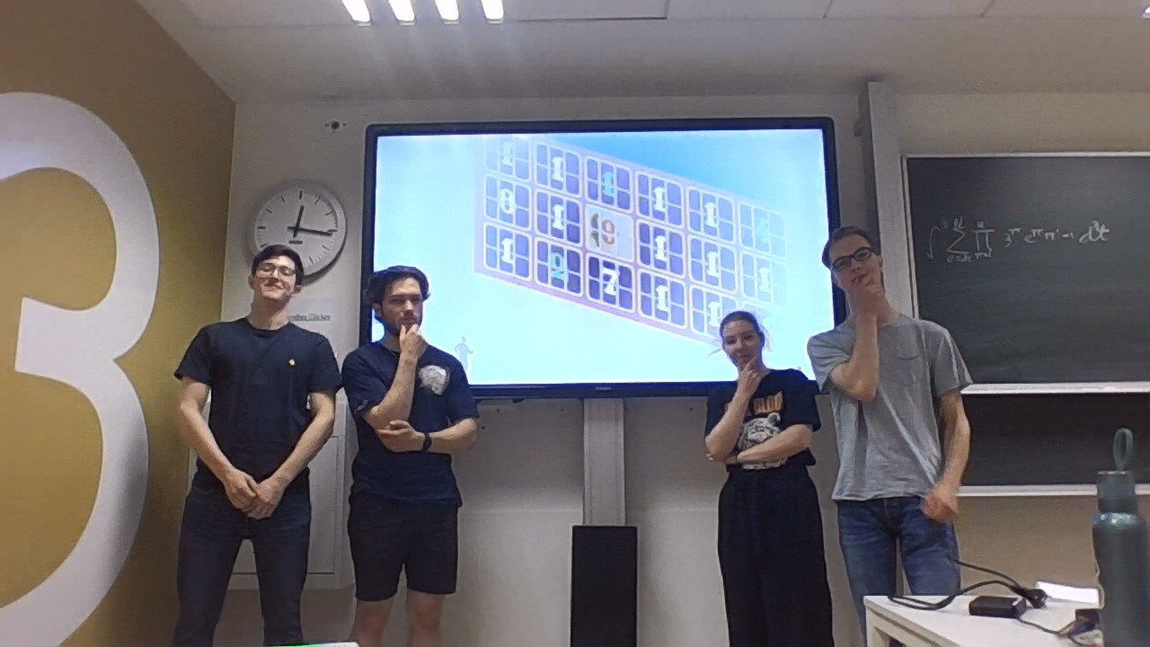

Slide 11
Table of contents
01
02
03
04
Simplified model
General problem introduction
First strategy
Different strategies
05
Conclusion

Slide 12
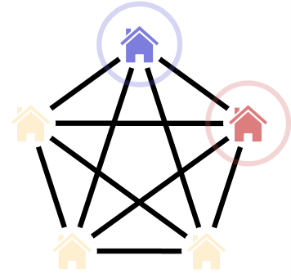
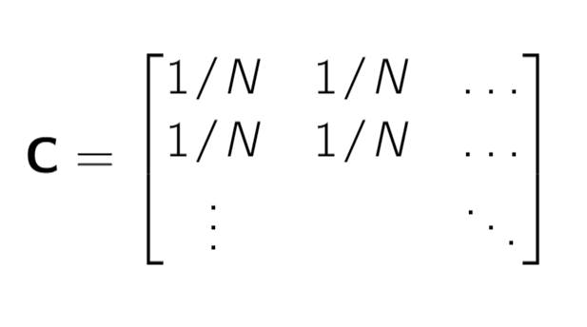
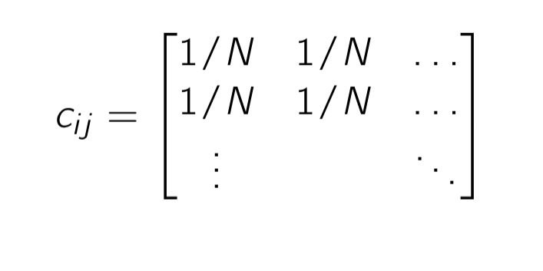
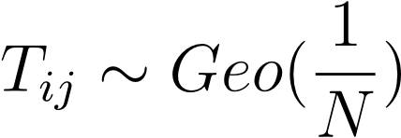
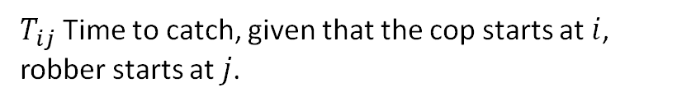
Simple model
$T_{ij}$Time to catch, given that the cop starts at $i$, robber starts at $j$.

Slide 13


Slide 14
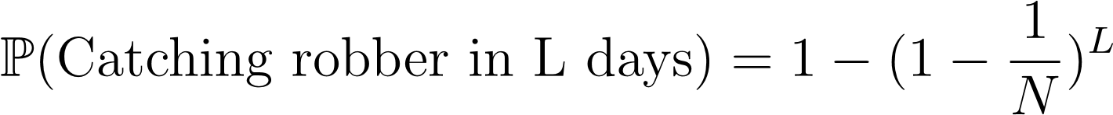
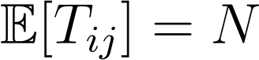
Simple model
$T_{ij}$Time to catch, given that the cop starts at $i$, robber starts at $j$.

Slide 15
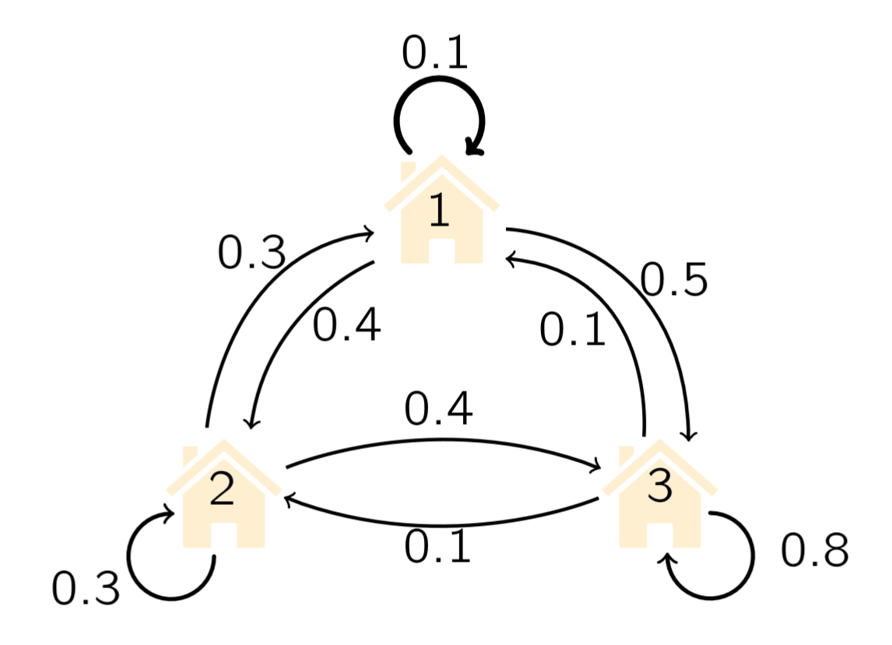
On the robber chain.

Slide 16
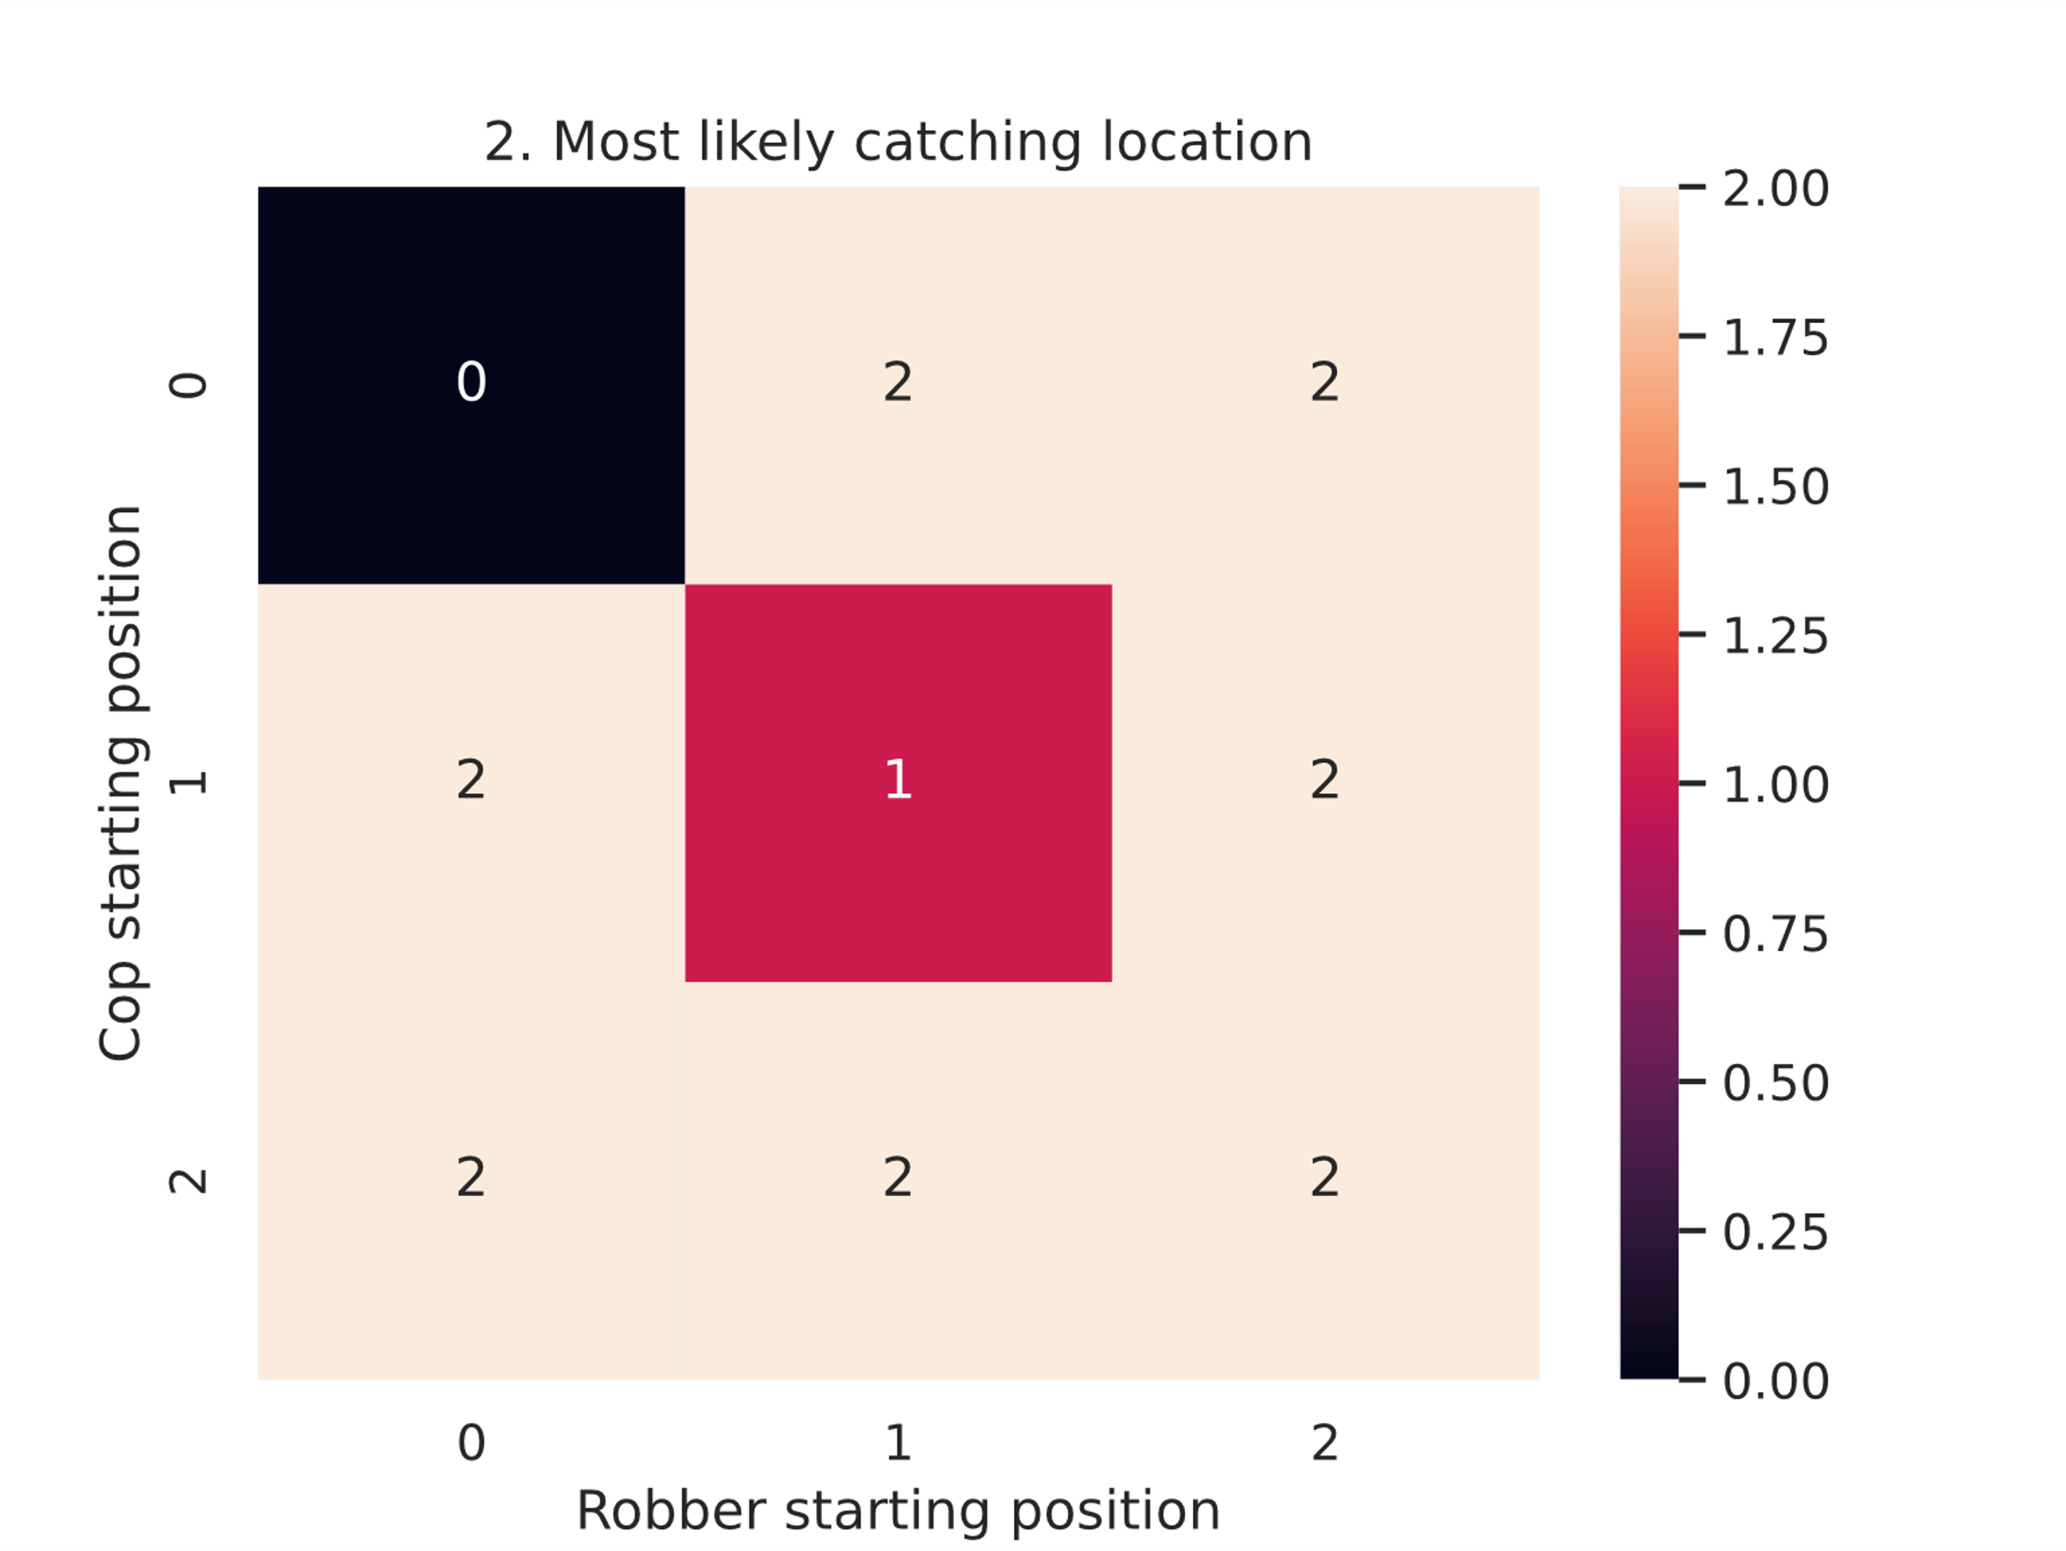
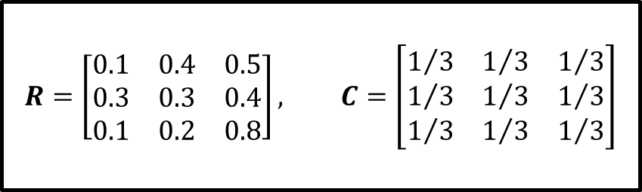
Strategy 1
$$R=\left[\begin{matrix}0.1 & 0.4 & 0.5 \\ 0.3 & 0.3 & 0.4 \\ 0.1 & 0.2 & 0.8\end{matrix}\right], C=\left[\begin{matrix}1/3 & 1/3 & 1/3 \\ 1/3 & 1/3 & 1/3 \\ 1/3 & 1/3 & 1/3\end{matrix}\right]$$

Slide 17
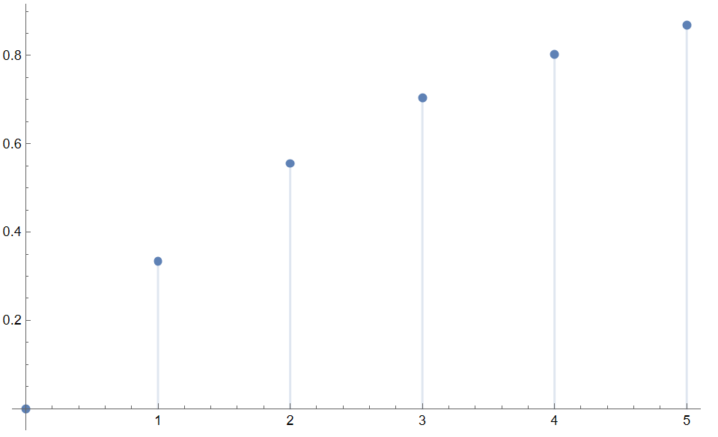
Days

Slide 18
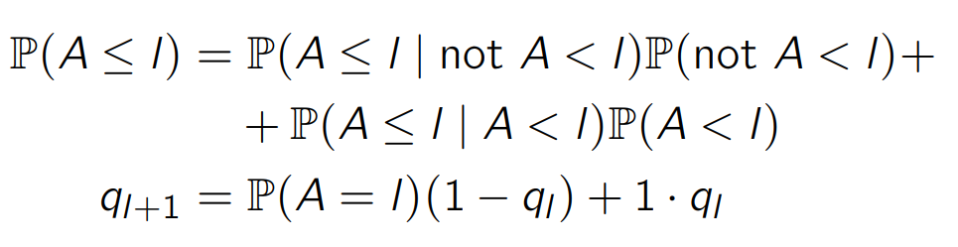
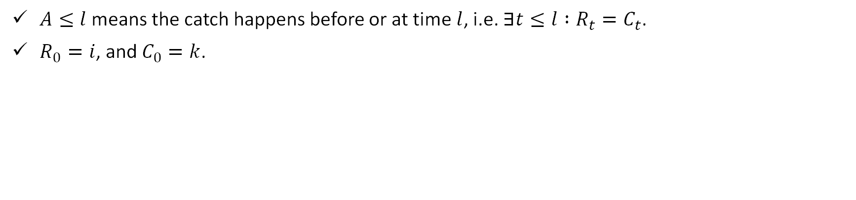
General approach
Breaking up the catching probability
$A≤l$ means the catch happens before or at time$l$, i.e. $∃t≤l :R_{t}=C_{t}$.
$R_{0}=i$, and $C_{0}=k$.

Slide 19
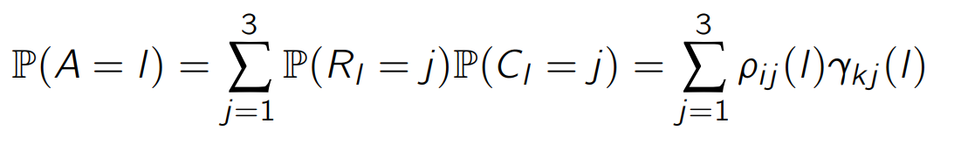
General approach
Breaking up the catching probability more
Definition of catching probability
Can sometimes be simplified depending on the strategy

Slide 20
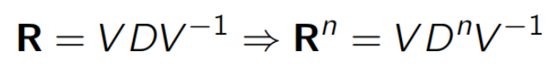
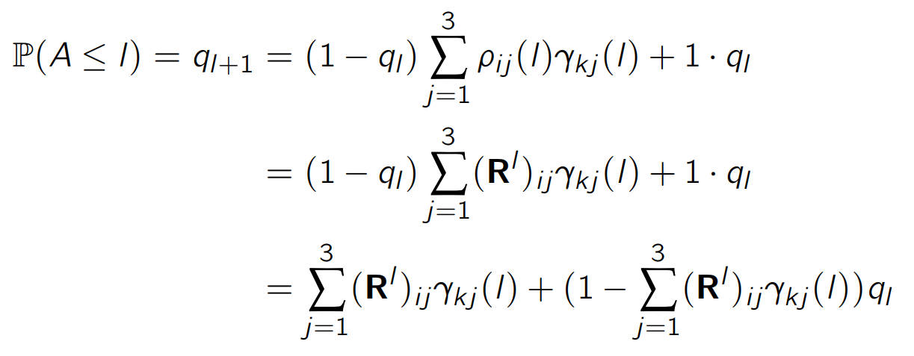
General approach
Substituting everything in

Slide 21
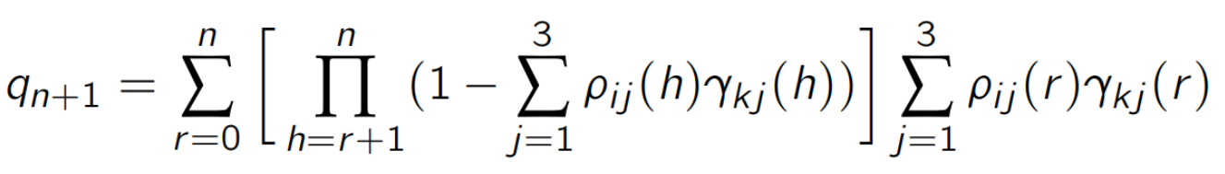
General approach
The final result!
A
A
(but is it useful?)

Slide 22
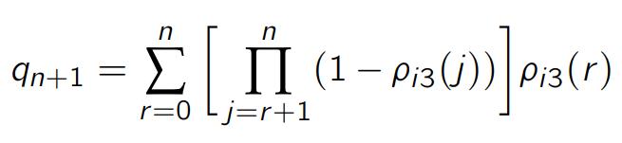
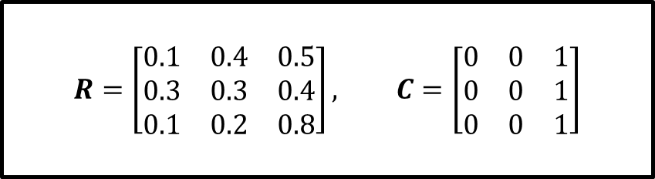
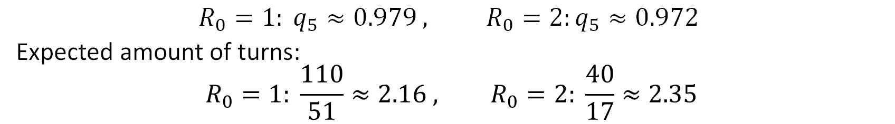
Strategy 2
$$R=\left[\begin{matrix}0.1 & 0.4 & 0.5 \\ 0.3 & 0.3 & 0.4 \\ 0.1 & 0.2 & 0.8\end{matrix}\right], C=\left[\begin{matrix}0 & 0 & 1 \\ 0 & 0 & 1 \\ 0 & 0 & 1\end{matrix}\right]$$
Cop stays at most visited house
$$R_{0}=1: q_{5}≈0.979 , R_{0}=2:q_{5}≈0.972$$
Expected amount of turns:
$$R_{0}=1: \frac{110}{51}≈2.16 , R_{0}=2: \frac{40}{17}≈2.35$$

Slide 23
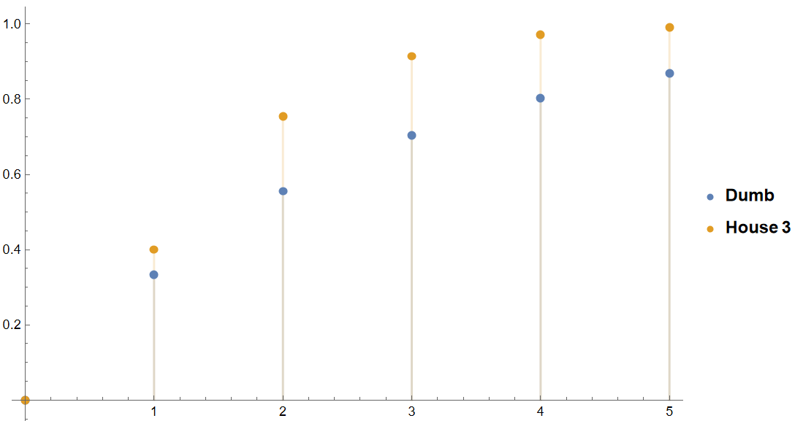

Slide 24
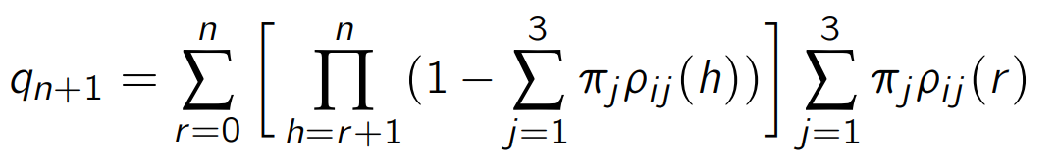
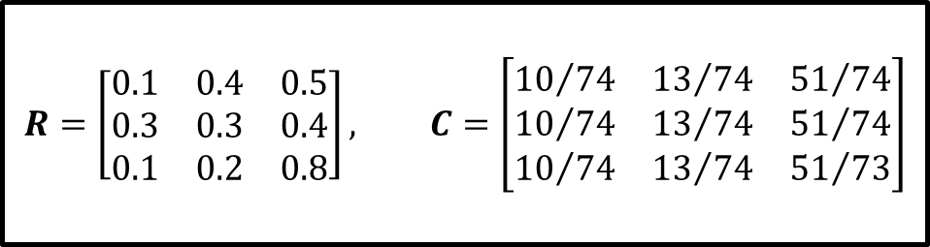
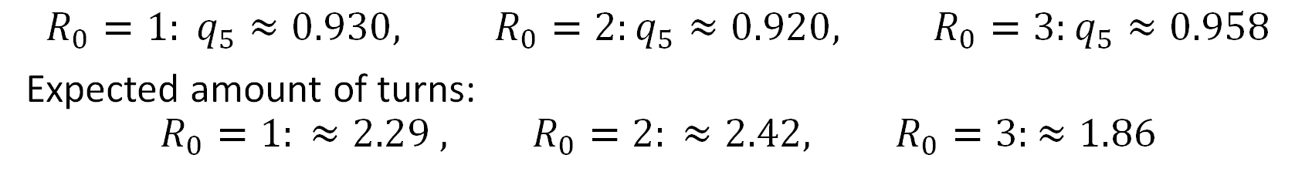
Strategy 3
$$R=\left[\begin{matrix}0.1 & 0.4 & 0.5 \\ 0.3 & 0.3 & 0.4 \\ 0.1 & 0.2 & 0.8\end{matrix}\right], C=\left[\begin{matrix}{10}/{74} & {13}/{74} & {51}/{74} \\ {10}/{74} & {13}/{74} & {51}/{74} \\ {10}/{74} & {13}/{74} & {51}/{73}\end{matrix}\right]$$
Cop picks stationary distribution
Unfortunately, no real ‘trick’ possible
$$R_{0}=1: q_{5}≈0.930, R_{0}=2:q_{5}≈0.920, R_{0}=3:q_{5}≈0.958$$
Expected amount of turns:
$$R_{0}=1: ≈2.29 , R_{0}=2: ≈2.42, R_{0}=3:≈1.86$$

Slide 25
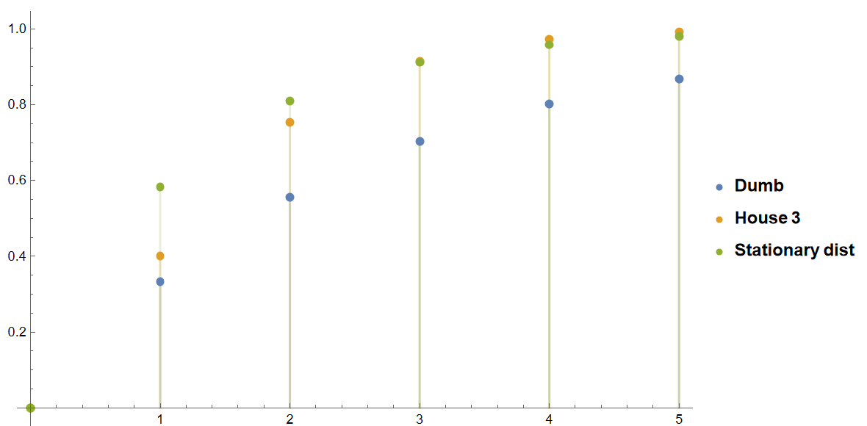

Slide 26
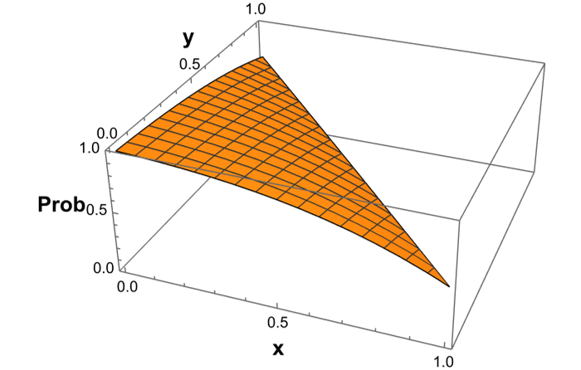
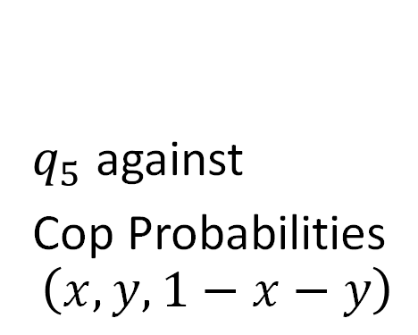
Strategy comparison
$q_{5}$ against
Cop Probabilities
$$\left(x,y,1−x−y\right)$$

Slide 27
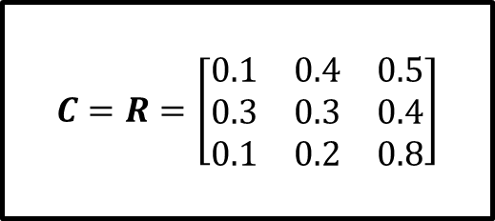
Strategy 4
$$C=R=\left[\begin{matrix}0.1 & 0.4 & 0.5 \\ 0.3 & 0.3 & 0.4 \\ 0.1 & 0.2 & 0.8\end{matrix}\right]$$
Cop thinks like the robber

Slide 28
Strategy 4
$$C=R=\left[\begin{matrix}0.1 & 0.4 & 0.5 \\ 0.3 & 0.3 & 0.4 \\ 0.1 & 0.2 & 0.8\end{matrix}\right]$$
Cop thinks like the robber

Slide 29
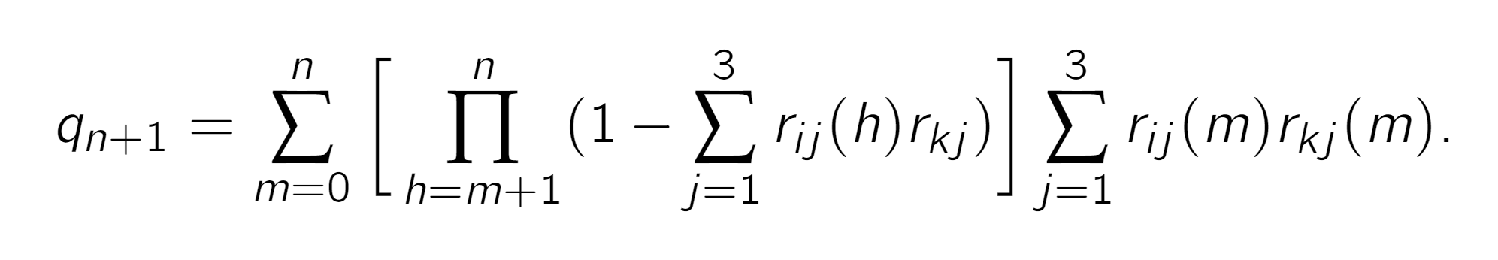
Strategy 4
$$C=R=\left[\begin{matrix}0.1 & 0.4 & 0.5 \\ 0.3 & 0.3 & 0.4 \\ 0.1 & 0.2 & 0.8\end{matrix}\right]$$
Cop thinks like the robber

Slide 30
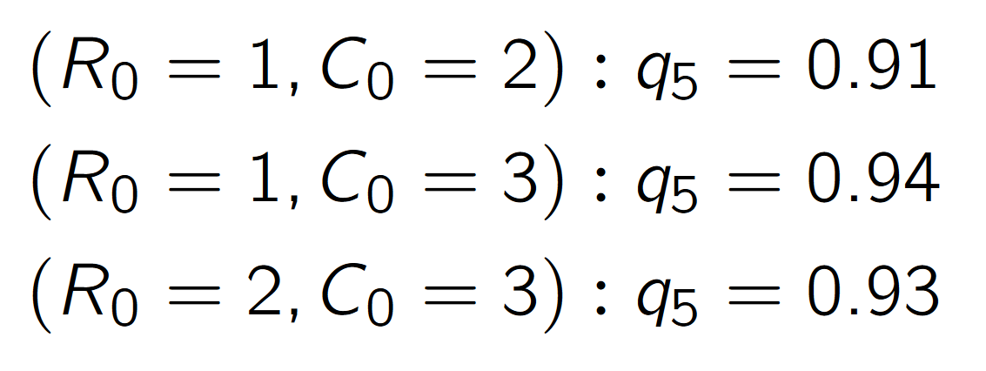
Strategy 4
$$C=R=\left[\begin{matrix}0.1 & 0.4 & 0.5 \\ 0.3 & 0.3 & 0.4 \\ 0.1 & 0.2 & 0.8\end{matrix}\right]$$
Cop thinks like the robber

Slide 31
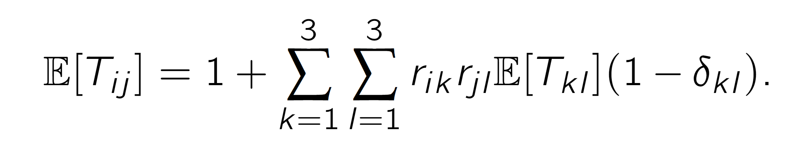
Strategy 4
$$C=R=\left[\begin{matrix}0.1 & 0.4 & 0.5 \\ 0.3 & 0.3 & 0.4 \\ 0.1 & 0.2 & 0.8\end{matrix}\right]$$
Cop thinks like the robber

Slide 32
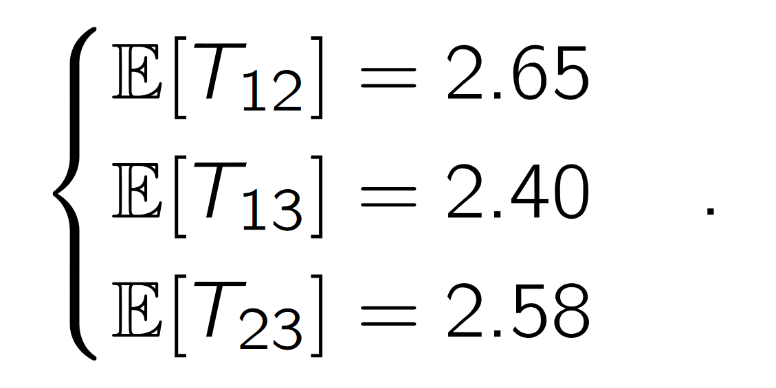
Strategy 4
$$C=R=\left[\begin{matrix}0.1 & 0.4 & 0.5 \\ 0.3 & 0.3 & 0.4 \\ 0.1 & 0.2 & 0.8\end{matrix}\right]$$
Cop thinks like the robber

Slide 33
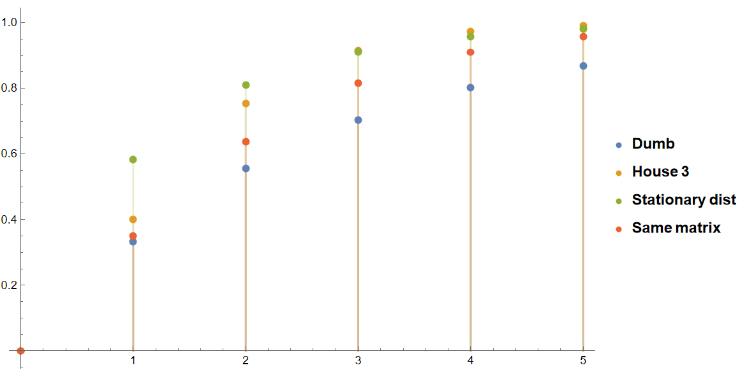

Slide 34
Conclusion
Cop can guarantee geometric catching time
Multiple ways to decrease expected catching time
Argmax; Optimal
Stationary distribution; Better than uninformed
Think like robber; Better than uninformed
General approach and solution
Verified some examples with calculations and simulation
Cop can get to work!

Slide 35
Questions, comments and concerns

